Slide 1


INFOSYS SPRINGBOARD INTERNSHIP 5.0
VOICE BASED PATIENT CALL SYSTEM
Care Connect
Presented By
Mentored By
Presented by
Mentored by
PURBASA BHADURI
SHILPIE
AI Intern BATCH - 3

Slide 2


A Voice-Based Patient Call System is an AI-powered healthcare solution designed to enhance communication between patients and medical staff. This system allows patients, especially those with mobility challenges or critical conditions, to request assistance using voice commands instead of relying on traditional nurse call buttons or manual alerts.
WHAT IS
VOICE BASED PATIENT CALL SYSTEM
?

Slide 3
Delayed response time
Faster Response
WHY
VOICE BASED PATIENT CALL SYSTEM
Insufficient Workflow
?
Real-Time Alerts
Improves patient experience, reduces nurse workload, and modernizes hospital communication with AI-driven automation.
Outdated Call Systems
Voice Based Assistence

Slide 4
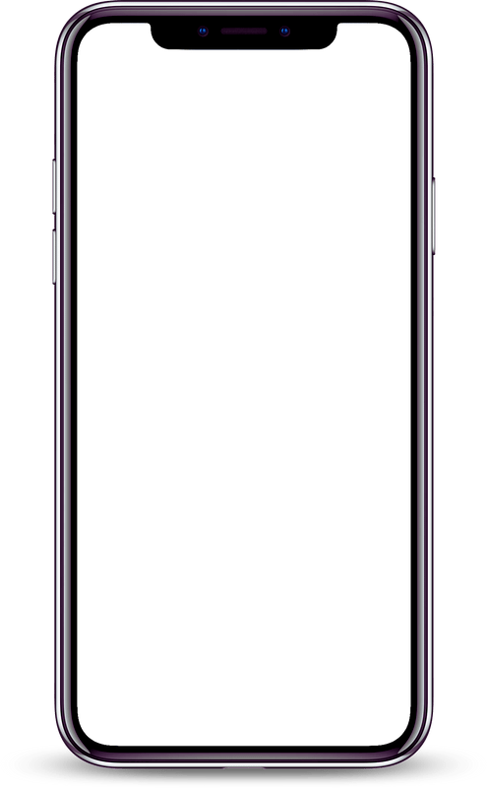
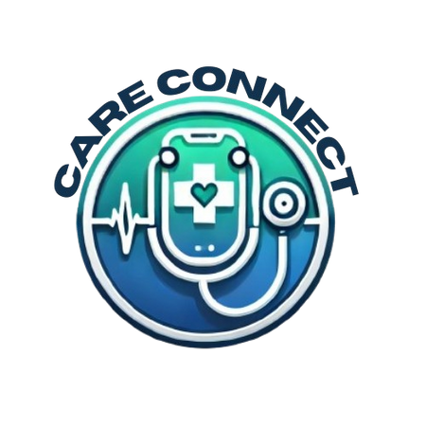
OUR APP
Care Connect
Care Connect is a voice-based patient call system designed to enhance patient care by enabling hands-free voice communication between patients and medical staff.
It is an AI-driven, voice-activated solution for hospitals that ensures quick response to patient needs, improving healthcare efficiency
Effortless communication for better patient care
WELCOME TO
CARE CONNECT

Slide 5
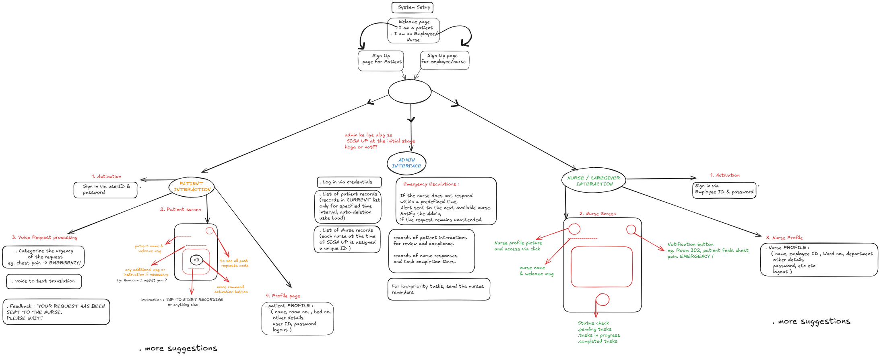
USER FLOW

Slide 6
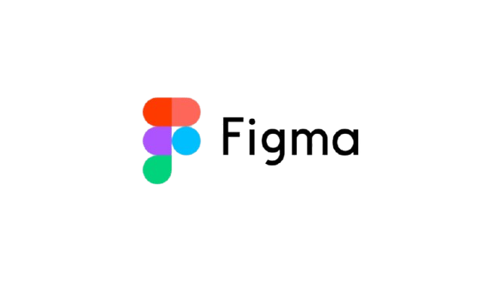
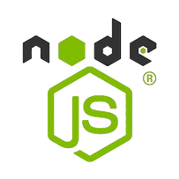




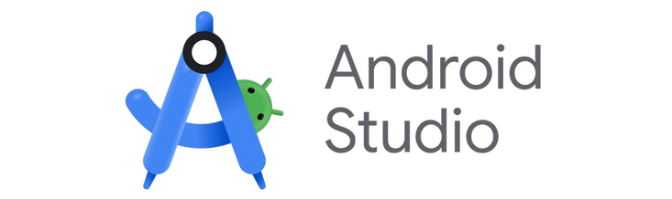

TECH STACK
Figma
Node Js
App UI designing
Building Back-end server
Reactive Native
Azure
Front-end development
AI, NLP, speech to text
Expo Go
MongoDB
Building the app
Backend Data storage
Express JS
Android Studio
Creating RESTful APIs
Testing & debugging

Slide 7

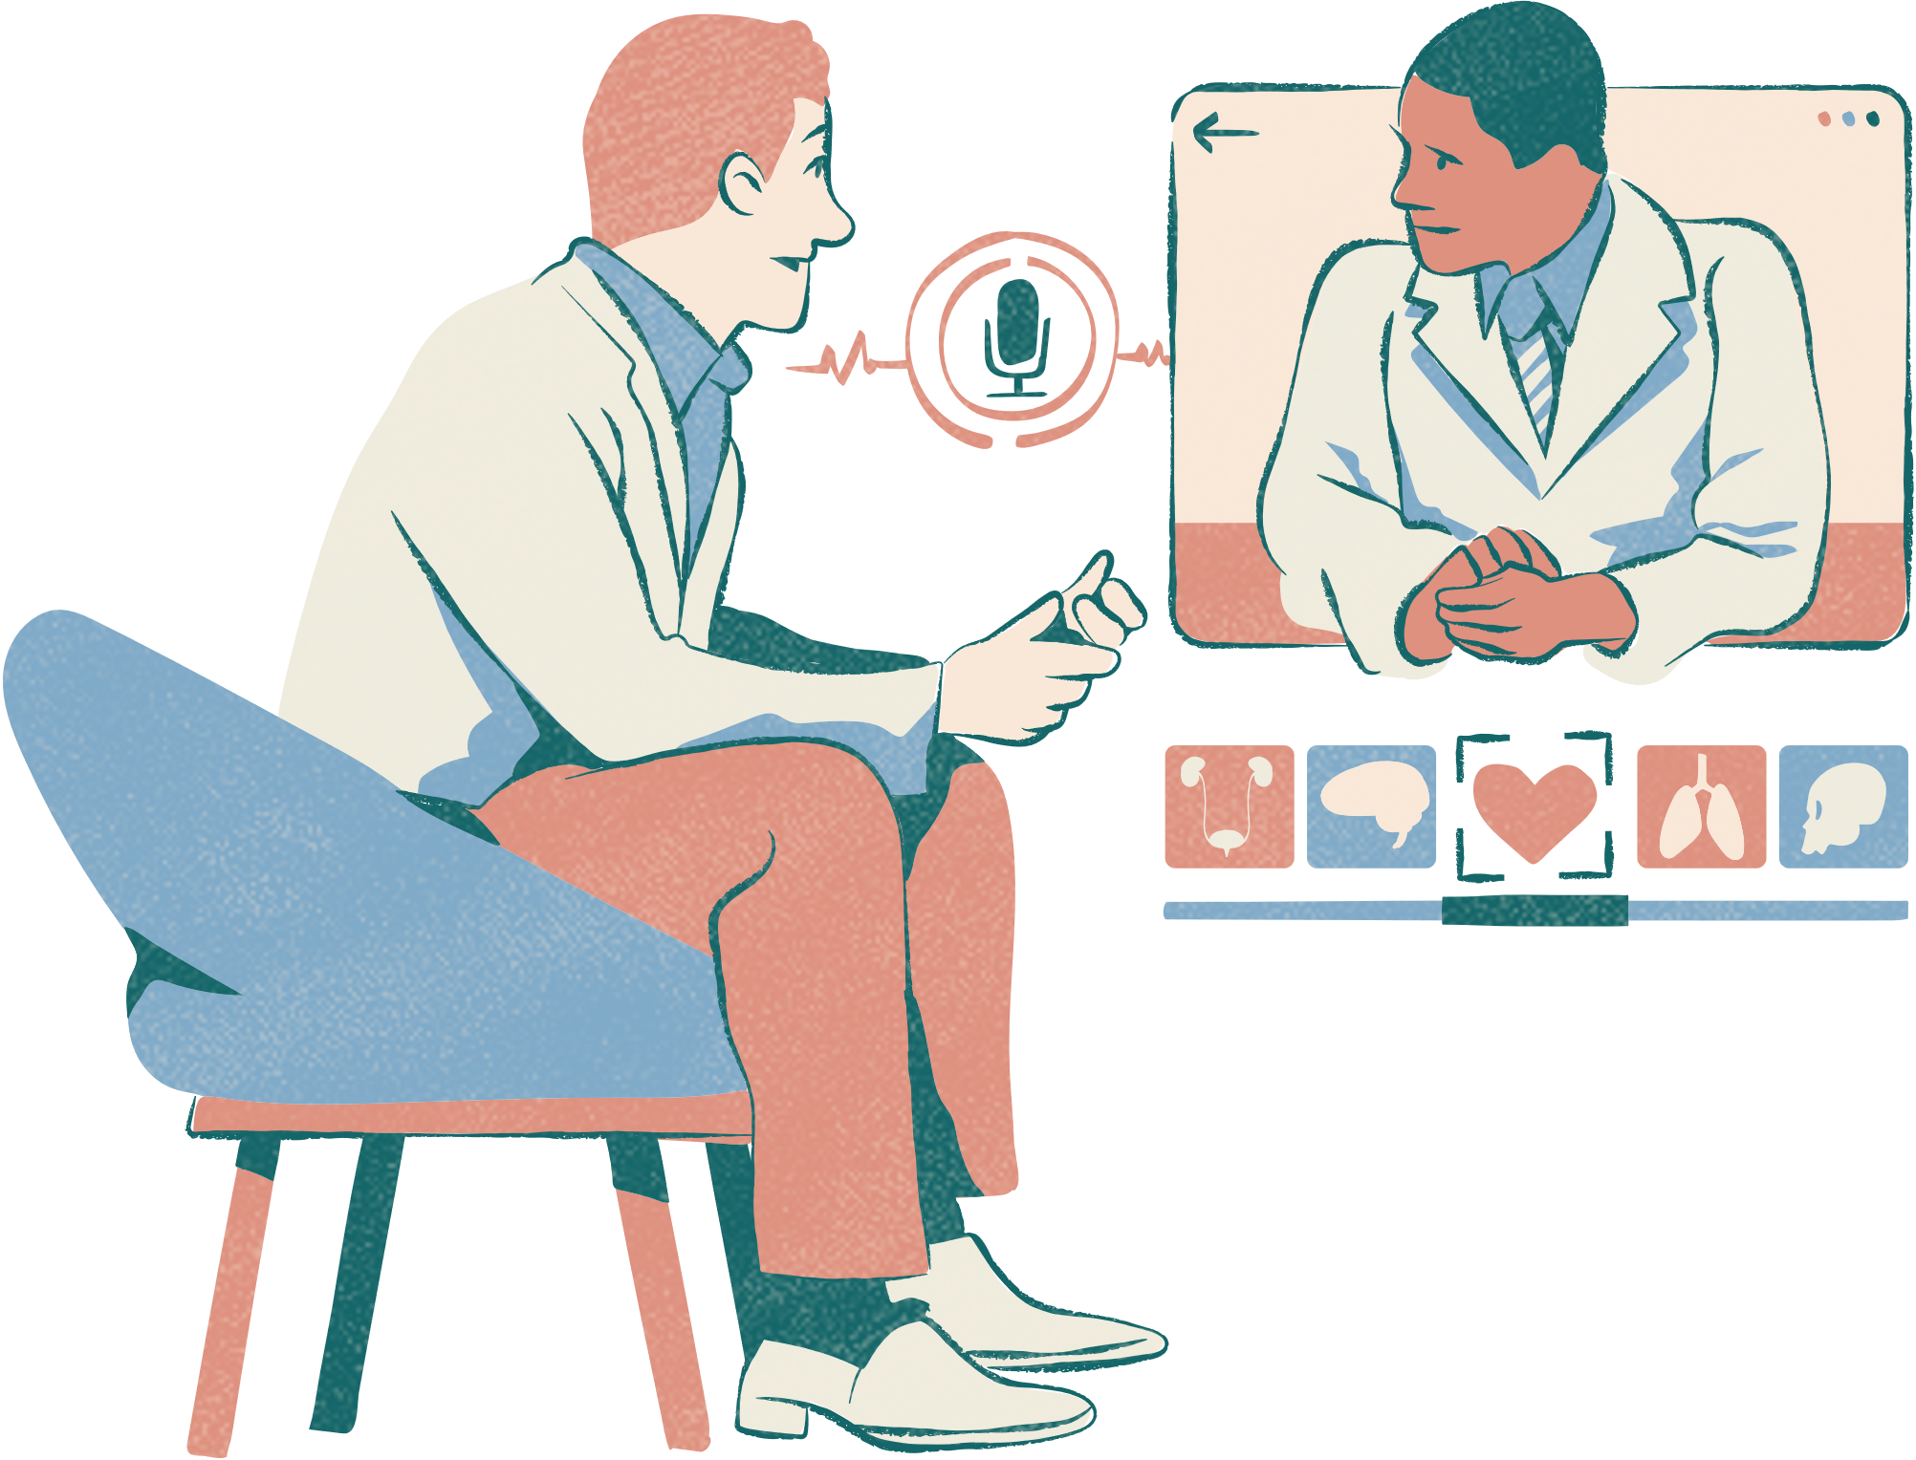




SYSTEM ARCHITECTURE
Care Connect transforms patient assistance by replacing outdated call buttons with voice-based AI. Patients simply say a command, and the system immediately notifies the medical staff through real-time alerts, reducing response time and improving workflow efficiency.
Voice-Based Patient Calls
Instant Alerts for Nurses & Caregivers
Request classification to High, Medium and Low
User-Friendly Mobile Interface
Role-Based Login for Patients & Staff

Slide 8
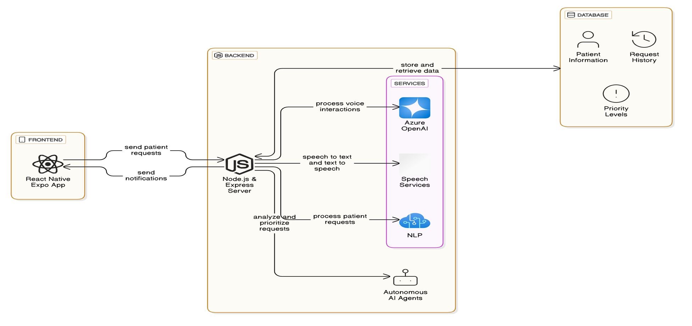
SYSTEM DIAGRAM

Slide 9

CHALLENGES
Solutions
Challenges
The speech-to-text system struggled with varying accents, noise interference, and medical jargon.
Designing a scalable database for multiple hospitals to handle diverse patient data and real-time requests.
Tuned the API parameters for accuracy and utilized Azure Speech Services with a domain-specific vocabulary.
Used MongoDB for its flexible schema and horizontal scaling capabilities.

Slide 10




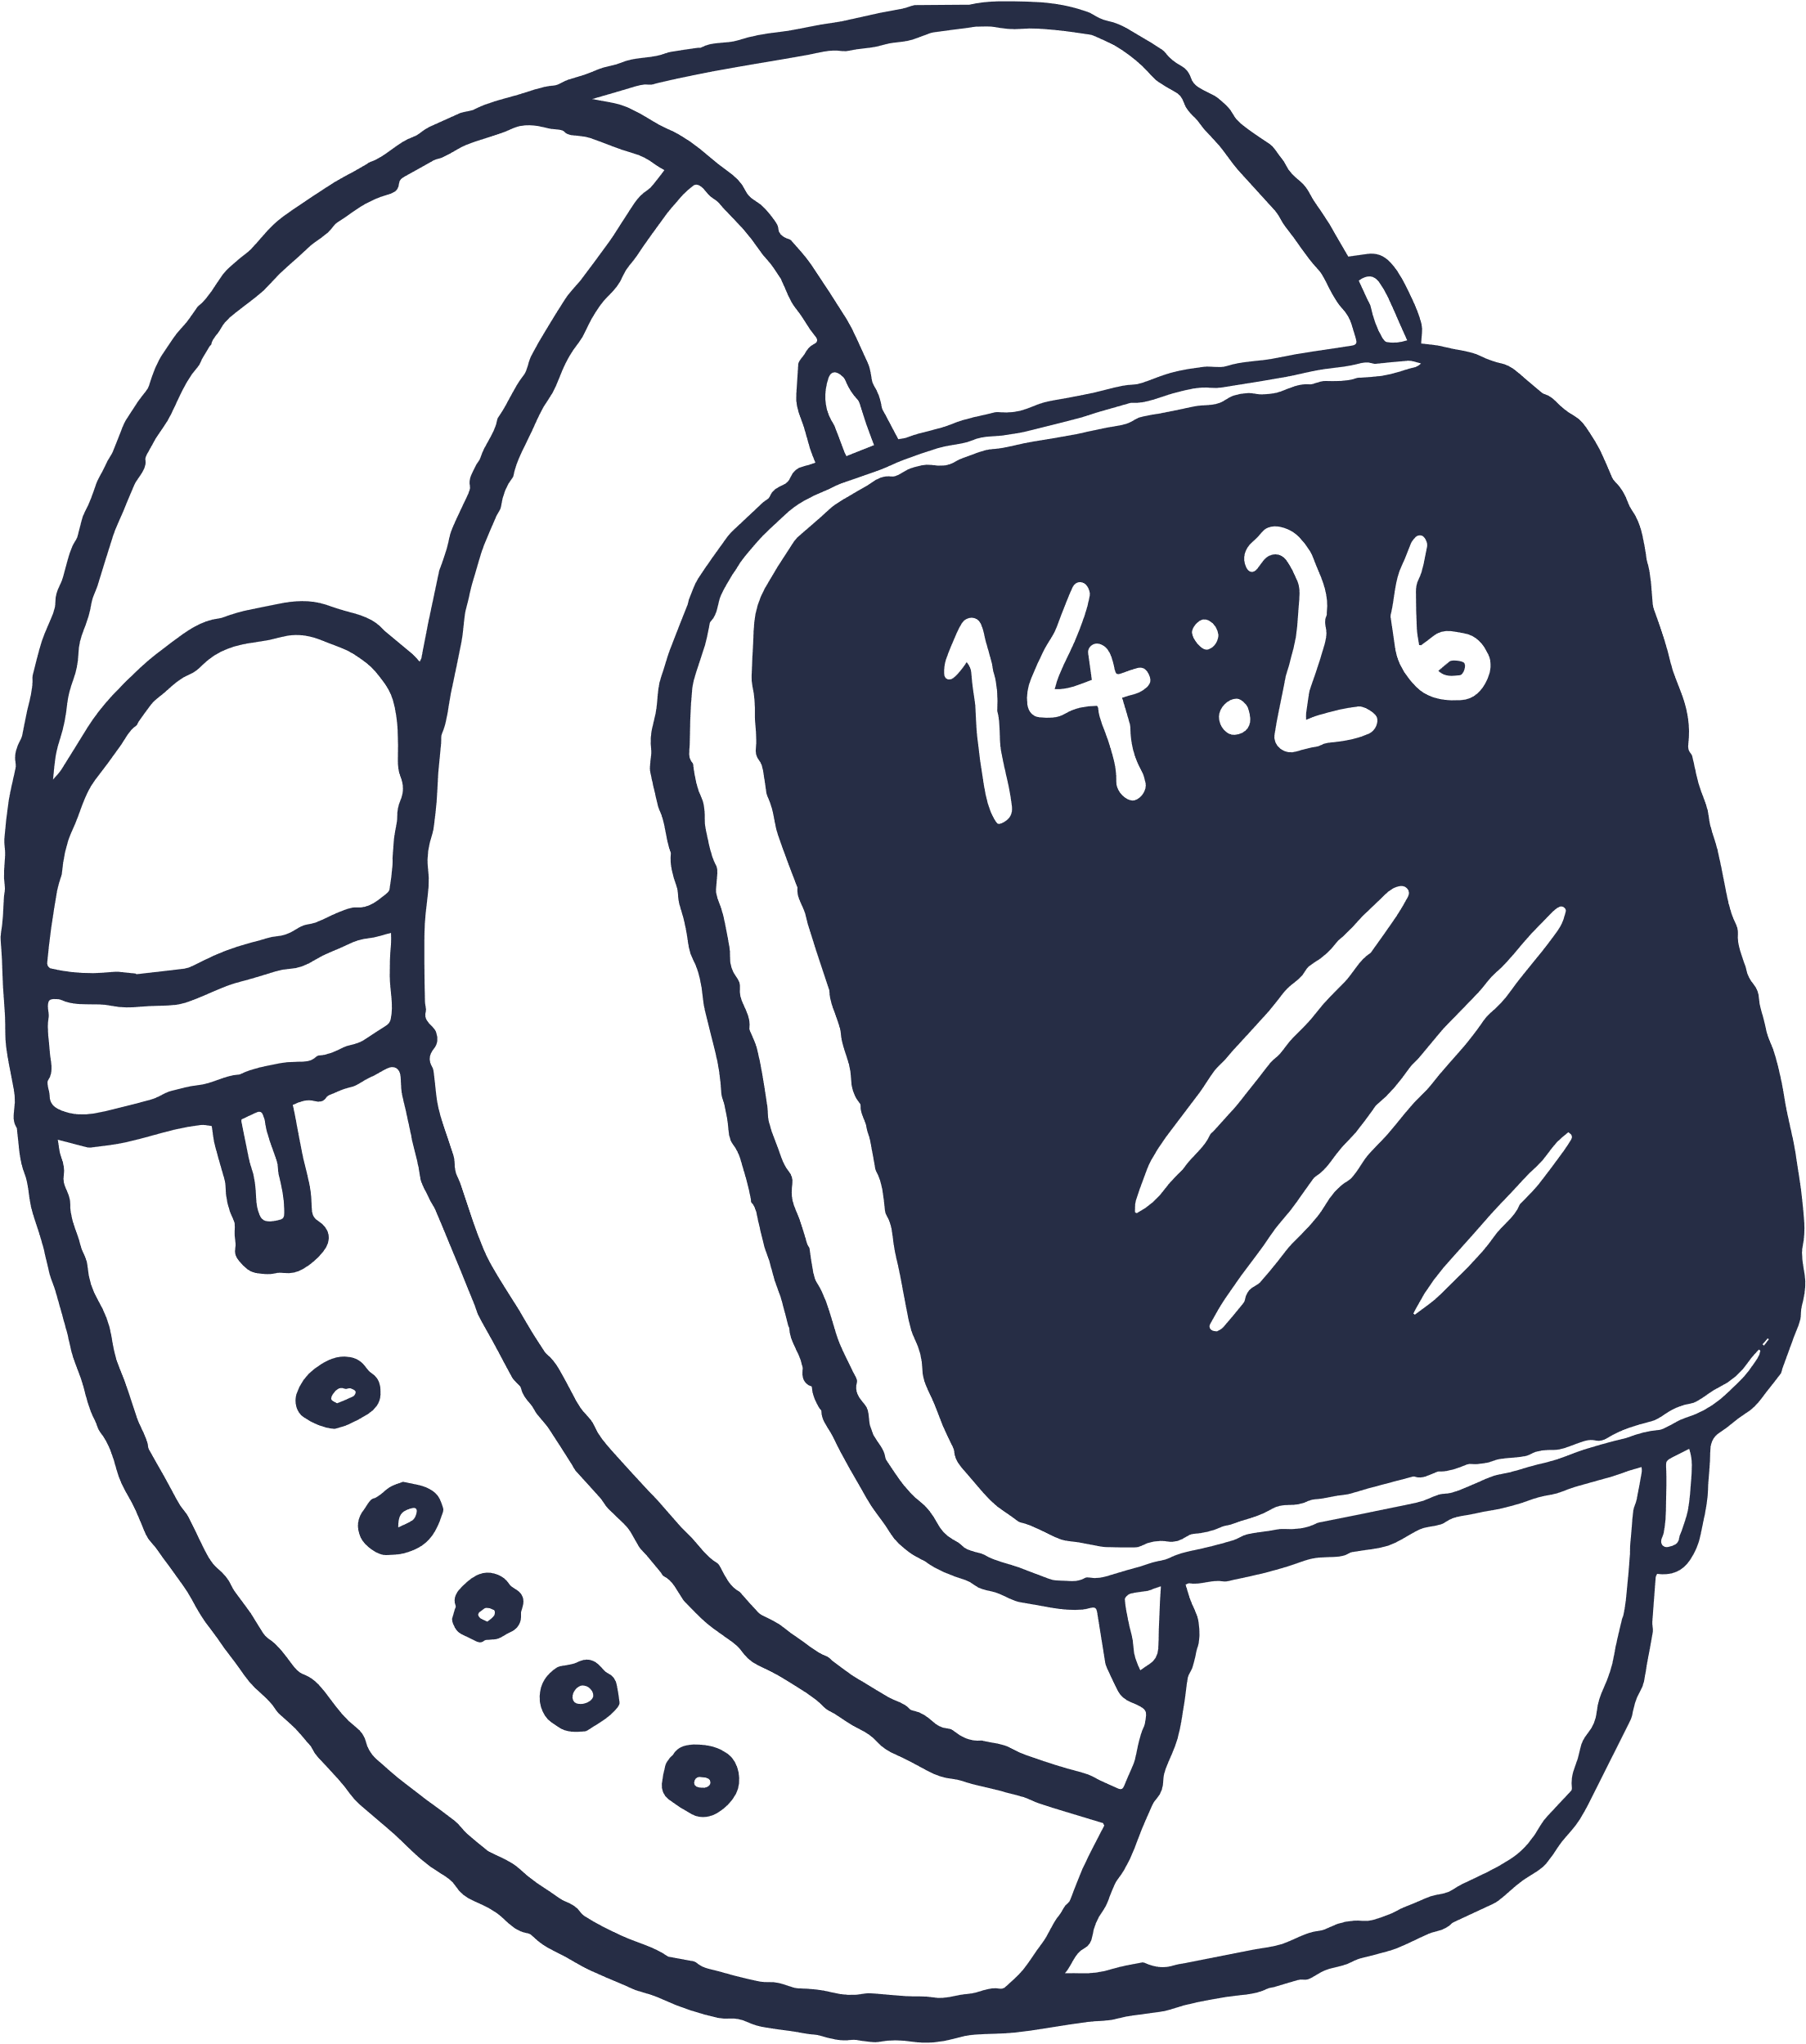
Multi-Language Support : Extend the app to support multiple languages, catering to patients from diverse linguistic backgrounds.
AI-Powered Predictive Alerts : Implement machine learning models to predict emergencies based on patient health data trends, generate proactive alerts and recommend preventive measures.
SCOPE
Integration with IoT Hospital Systems : Connect with IoT devices like patient monitors and wearables to provide real-time health updates and automated alerts.
Virtual Assistant for Chronic Conditions :
Provide personalized support and guidance for patients with chronic conditions.

Slide 11




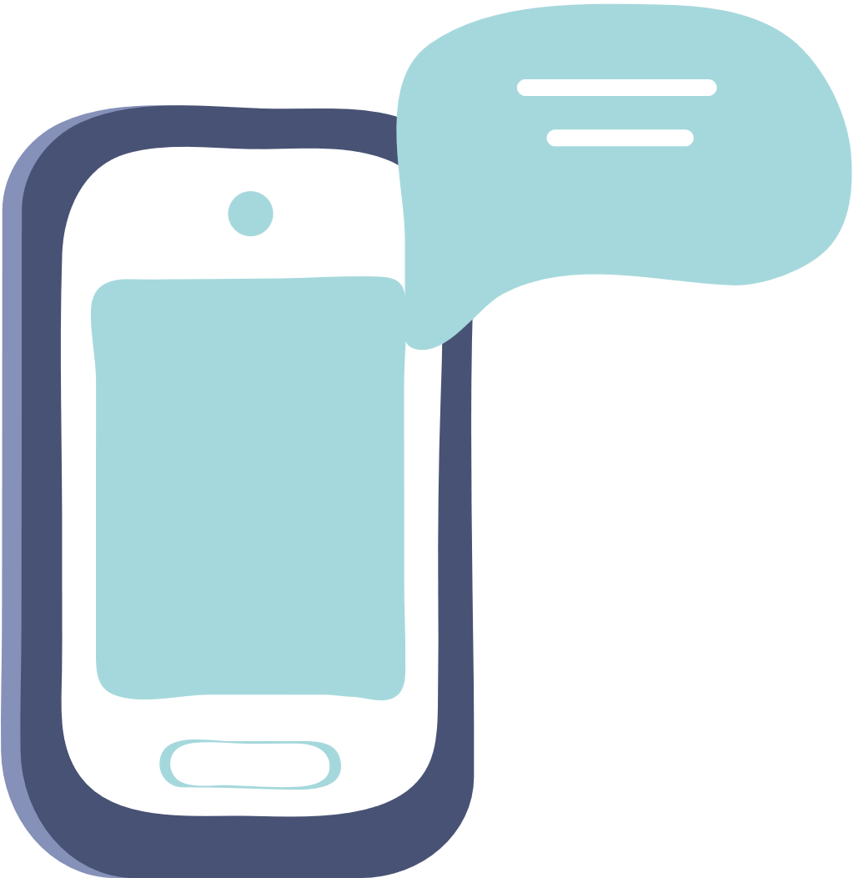




THANK YOU

